Slide 1
CEIS310 Module 4
Accessing and Exploring Machine Learning Datasets and Generating Your Own Dataset
Edward Alvarado
11/19/2022

Slide 2
Rubric
Performance | Fail | Good | Excellent
Dataset Screenshot | No screenshot was submitted. | The screenshot does not show Kaggle or UCI websites. | The screenshot shows Kaggle and UCI websites.
Points | 0 | 10 | 20
Activity 1 Screenshot | No screenshot was submitted. | The screenshot does not show output or code. | The screenshot included code and output.
Points | 0 | 20 | 30
Activity 2 Screenshot | No screenshot was submitted. | The screenshot does not show output or code. | The screenshot included code and output.
Points | 0 | 20 | 30

Slide 3
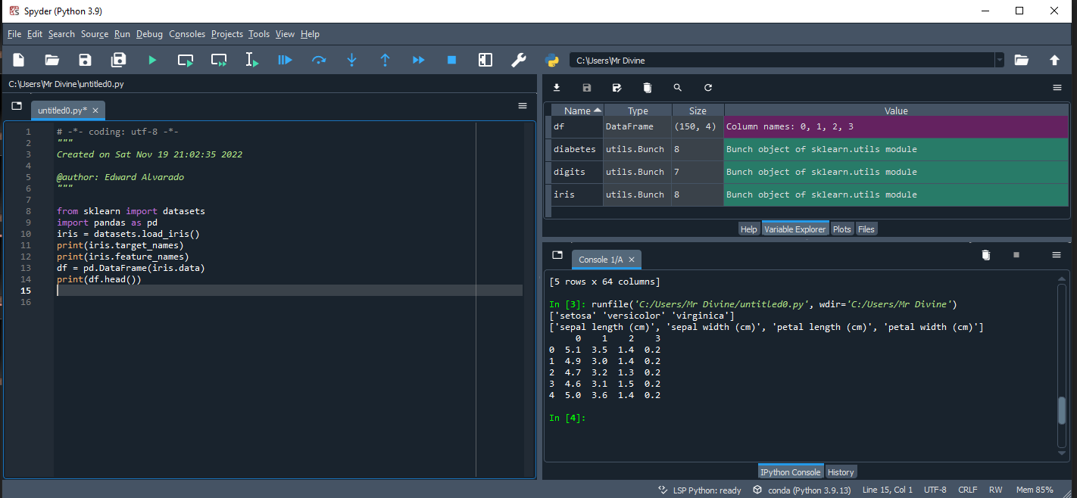
Screenshot of Activity 1
Include a screenshot from Spyder showing your Python code and screen output for Activity 1 with your name and date in the comments.

Slide 4
Screenshot of Dataset
Include a screenshot from Windows Explorer showing the dataset you explored at Kaggle and UCI websites furnished to you.
Name three interesting datasets you find at the Kaggle website.
Esports Earnings Dataset. Money earned by Players and Teams from eSports Tournaments
https://www.kaggle.com/datasets/jackdaoud/esports-earnings-for-players-teams-by-game
RuneScape Grand Exchange Data. The data set contains the daily price average for items listed on the RuneScape 3 grand exchange from 2008 to today. Prices within the grand exchange fluctuate based on player supply and demand.
https://www.kaggle.com/datasets/aparoski/runescape-grand-exchange-data
COVID -19 Coronavirus Pandemic Dataset
https://www.kaggle.com/datasets/whenamancodes/covid-19-coronavirus-pandemic-dataset
Name three interesting datasets you find at the UCI.
Speaker Accent Recognition Data Set
https://archive.ics.uci.edu/ml/datasets/Speaker+Accent+Recognition
Absenteeism at work Data Set
https://archive.ics.uci.edu/ml/datasets/Absenteeism+at+work
Bias correction of numerical prediction model temperature forecast Data Set
https://archive.ics.uci.edu/ml/datasets/Bias+correction+of+numerical+prediction+model+temperature+forecast

Slide 5
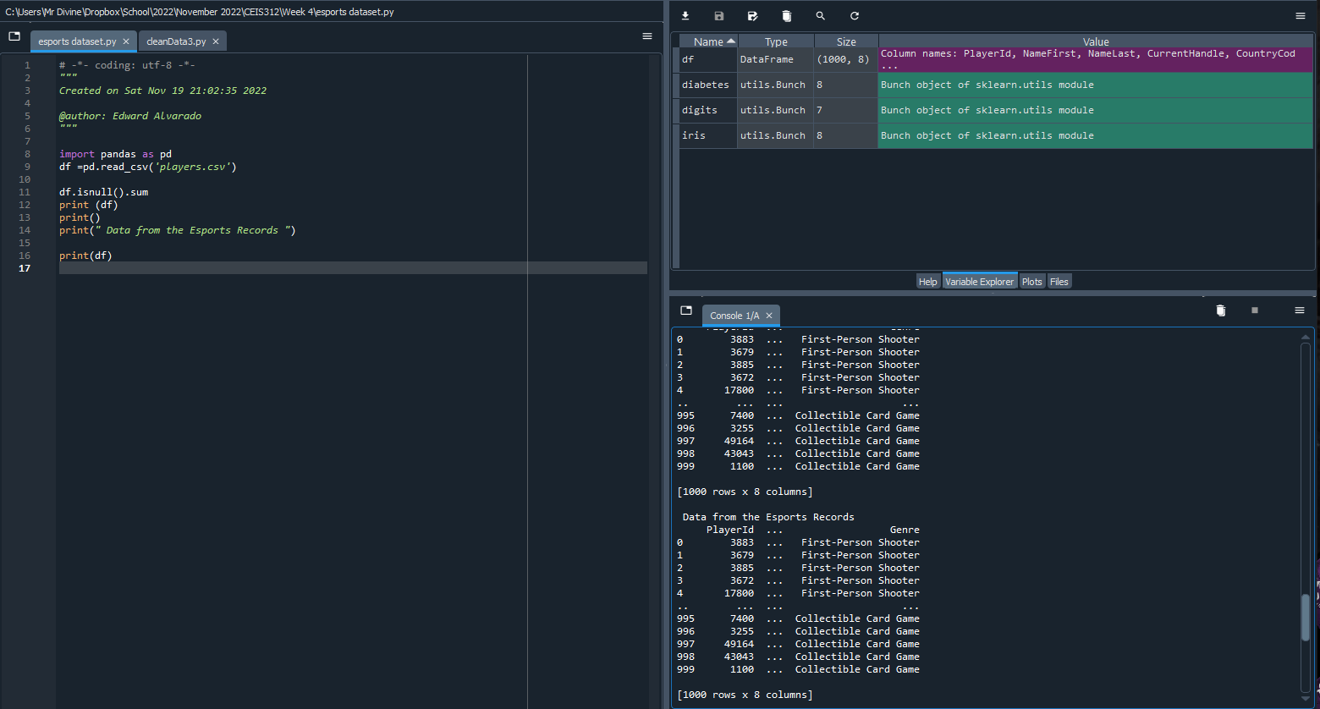
Screenshot of Activity 2
Include a screenshot from Spyder showing your Python code and screen output for Activity 2 with your name and date in the comments.

